Slide 1
A first look at browser-based cryptojacking
Shayan eskandari*, andreas leoutsarakos*, troy mursch^{Ɨ}, Jeremy clark*
*Concordia University, ^{Ɨ}bad packets report

Slide 2




Author
Shayan Eskandar
PhD Candidate
Concordia University
Blockchain
A. Leoutsarakos
Engineer
Concordia University
Blockchain, ATOMBit
Wallet CEO
Troy Mursch
Researcher
Bad Packets Report
Enterprise Monitoring
Tools, Security
Jeremy clark
Professor
Concordia University
Bitcoin, SSL/TLS
HTTPS

Slide 3

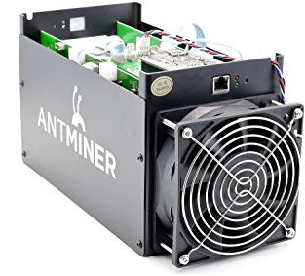



How to get Cryptocurrencies?

Slide 4
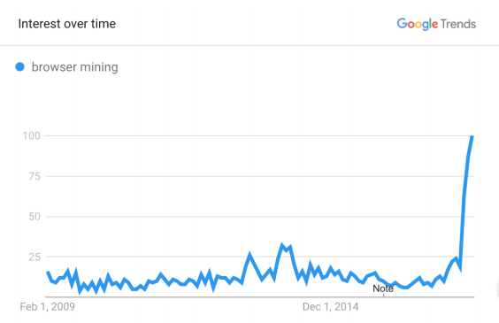
Re-emerging browser mining
As the year passed, the concept of browser mining become forgotten
Recently, the browser mining re-emerged
Why???

Slide 5
Cryptojacking
Invisible use of vulnerable user’s computational resources to mine cryptocurrencies
Based on browser-based coin mining
Can noticeably degrade performance
Also known as Coinjaking, Drive-by mining

Slide 6
Browser-based Mining
Bitcoin Plus, JSMiner(2011), Minechurch(2014)
Well optimized for Javascript
Replacing Ads by mining BTC
Limitation
1.5x Slower than CPU Miner
Legal challenges

Slide 7
New methods for crypto-mining
ASICs
Application Specific Integrated Circuits
GPU Based blockchain mining (July 18th, 2010)
ASIC Bitcoin Mining boom (Mid 2012)
Mining Pool
Do small work slice, get rewards according to their computational effort
First done by slush(Dec 16th, 2010)

Slide 8
Monero
Alternative Bitcoin launched in Apr 2014
Usually used for Dark web market
Pseudonymous
Light transaction
Computation : Memory hard
Requires large set of bytes
Frequent R/W

Slide 9
Monero: Memory Hard
Requires large set of bytes
Requires L3 cache, 2MB or above.
ASIC has 1MB : Not suitable
Frequent Read and Write
R/W Speed is significant
Graphic card’s GDDR5 : Notably slower than L3
CPU suits for Monero mining

Slide 10
Coinhive
Importance of CPU on Monero cryptomining
Browser based cryptomining emerges
Browser based cryptomining can use multiple CPUs
Coinhive, Crypto-Loot, CoinHave, Ppoi

Slide 11
Threat Model
Webmaster initiated
Third-party services
Browser Extension
Breaches
Man-in-the-middle

Slide 12
Webmaster Initiated
Webmaster add mining script on her website
It could be informed or not informed
Usually used as alternative monetization
When AD service blocked
Russian Child Pornography website : earn $10,000/month

Slide 13
Third-party Services
Advertisement
There was a script injection on Youtube AD
It lasts for one week
Accessibility tools
Tracking, Analysis tool

Slide 14
Browser Extension
Not was limited in websites
A Chrome extension : Archive Poster
silently cryptojacking without user’s consent
Uploaded on Chrome Webstore for days
Used by 100,000+ users

Slide 15
Breaches
Hacker uses vulnerability to inject mining codes
LiveHelpNow’s SDK
Used by 1500 websites for chatting service
Browsealoud
United Kingdom government websites
Injected mining scripts to around 4200+ websites

Slide 16
Man-in-the-middle
Injected by the man-in-the-middle
ISP or Free Wifi Hoster can inject the mining code on non HTTPS traffic
FreeStarbucksWifi in Argentina

Slide 17
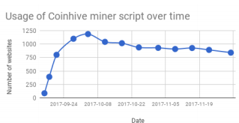
Measurement (1)
Coinhive, Alternative services
Run in 30,000+ websites (by PublicWWW)
Amazing growth in early days
Progress Slowdown after blocked by ADBlocker
Hard to recognize
JS Obfuscation, URL randomization
Authedmine is developed

Slide 18
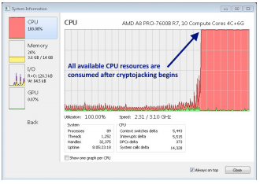
Measurement (2)
Client Impact
Early days, the mining code uses 100% of CPU resources
Nowadays, they use only around 25% of CPU resources
Hard to notice

Slide 19
Measurement (3)
Profitability
10 to 20 Active Miner : 0.3XMR($101) / month
Domain Parking Service
11000 sites, 105508 users, 24 seconds per each for 3 months
$1,085,346 for 3 months

Slide 20
Obtaining Consent
Obtaining consent from user before mining
Authedmine from coinhive
Limitation
Can detour by clickjacking
Sufficient understand must be given to user

Slide 21
Browser-level Mitigation
Throttling client scripting
Warning user for excessive resources consumption
Block well-known domains
Examples
Opera : No-coin blacklist
Brave-browser : JS Optimization to grow coinmining

Slide 22
Discussion
Cryptojacking on breached website
Definitely unethical
Obtaining User consent
Clear understand & proper rewards => FAIR
Unclear understand => UNFAIR
Should be debated
Without obtaining user consent
Invisible abuse

